Slide 1
Argumentative Writing
Name _______________ Date ____
CCSS: W.5.1a.b.c.d, 2.d, 8, RI.1.9, RF.5.4a
The opening stance or opinion
Evidence that you have gotten from texts and other reliable sources
Evidence from the opposing side.
Restating the claim.

Slide 2
Why do we argue?
What do you think the elements of a strong argument are?
_________________________________________________________________________________________________________________________________________________________________________________
_________________________________________________________________________________________________________________________________________________________________________________
_________________________________________________________________________________________________________________________________________________________________________________
_________________________________________________________________________________________________________________________________________________________________________________
Explain what it means to give a strong argument. Use the various organization and structure to explain how to give a strong argument.
_______________________________________________________________________________________________________________________________________________________________________________________
_______________________________________________________________________________________________________________________________________________________________________________________
_______________________________________________________________________________________________________________________________________________________________________________________

Slide 3
Elements to strong argumentative writing
Each element is 1 point!
Argumentative writing has the necessary qualities : claim, argument, counter argument, concluding statement
All arguments use convincing words or phrases with evidence from the text
Evidence is relevant and supportive of the claim
Writing is legible with correct punctuation and grammar
Total Score: / 4

Slide 4
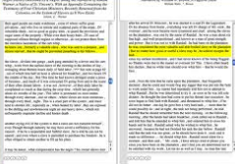
Convincing Language for an Argument and Counterargument
Convincing Language
Evidence from the Text
In fact
This suggests that
Due to
Furthermore
For instance
Strong Argument
In fact exercise each day is proven to keep weight down according to “Health Magazine”.
Always tell your reader where you got your information!
Counter Argument Language
Evidence from the Text
By contrast
In comparison
However
Although
Strong Counter Argument
However there are also studies such as the one in “Fitness” which indicate that proper nutrition may play a greater role in staying healthy.

Slide 5
How to decide if textual evidence will help my claim

Slide 6
What do you think? Should the government ban large sugary drinks to help consumers make healthier choices? Or should people be allowed make their own choices about beverage size?
- Time for Kids
claim
Argument 1
Argument 2
Argument 3
Counter Argument
Concluding statement

Slide 7
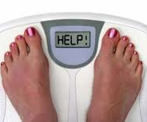
Vocabulary to be aware of while reading
Obesity epidemic
Banned
Regulate
16 Ounces
Consumer

Slide 8
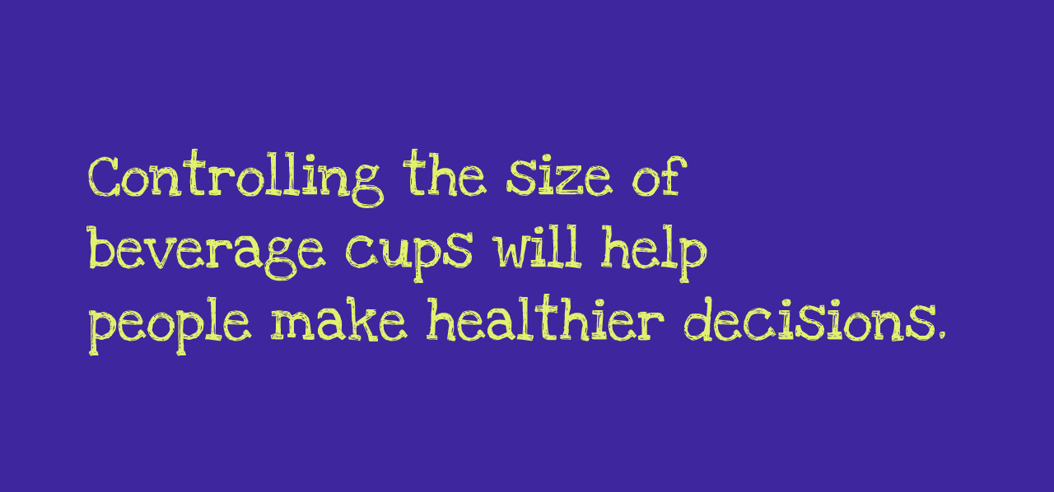

Slide 9
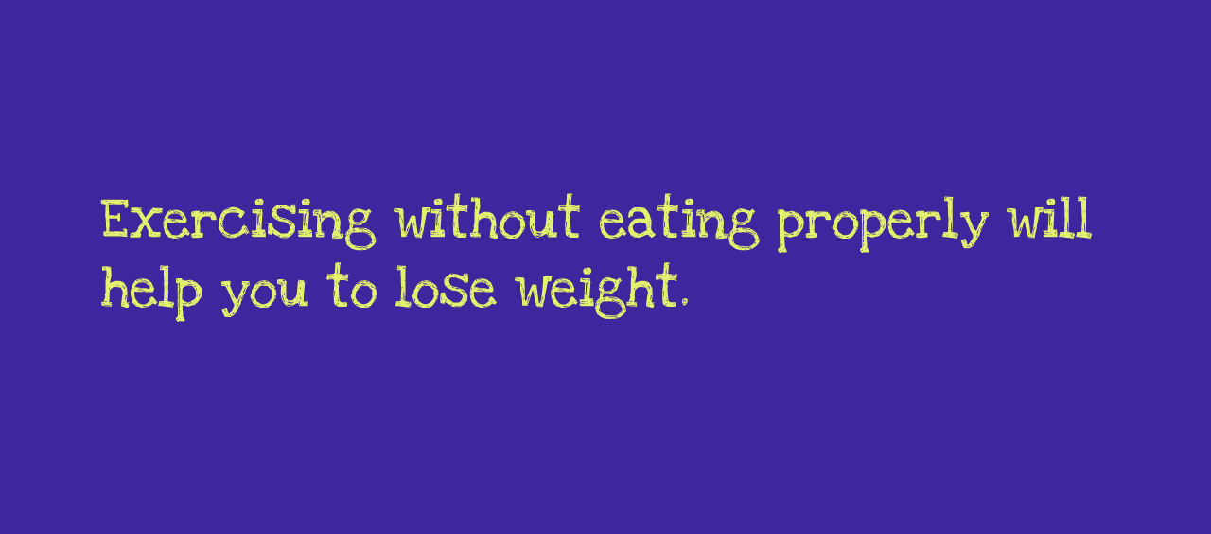

Slide 10
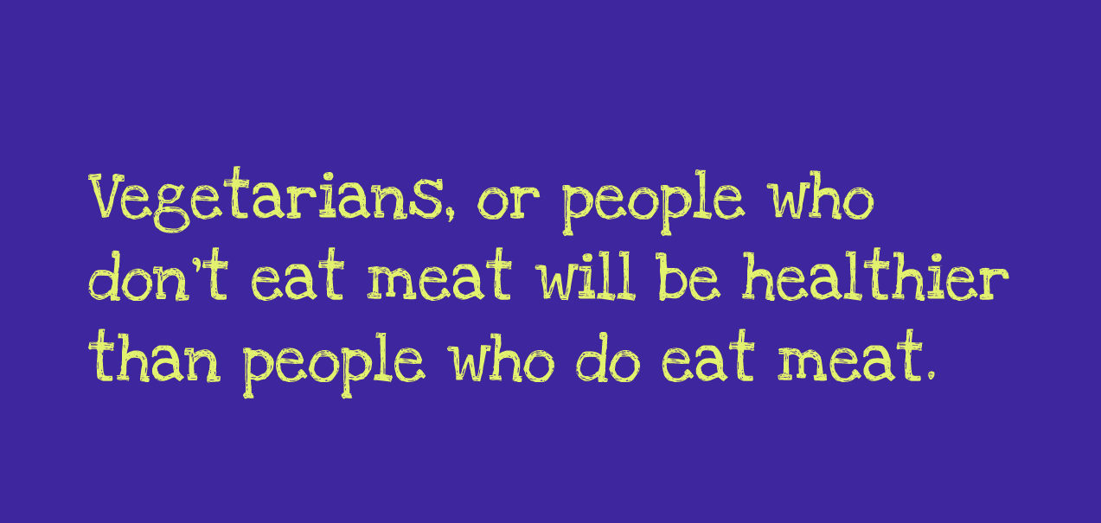

Slide 12
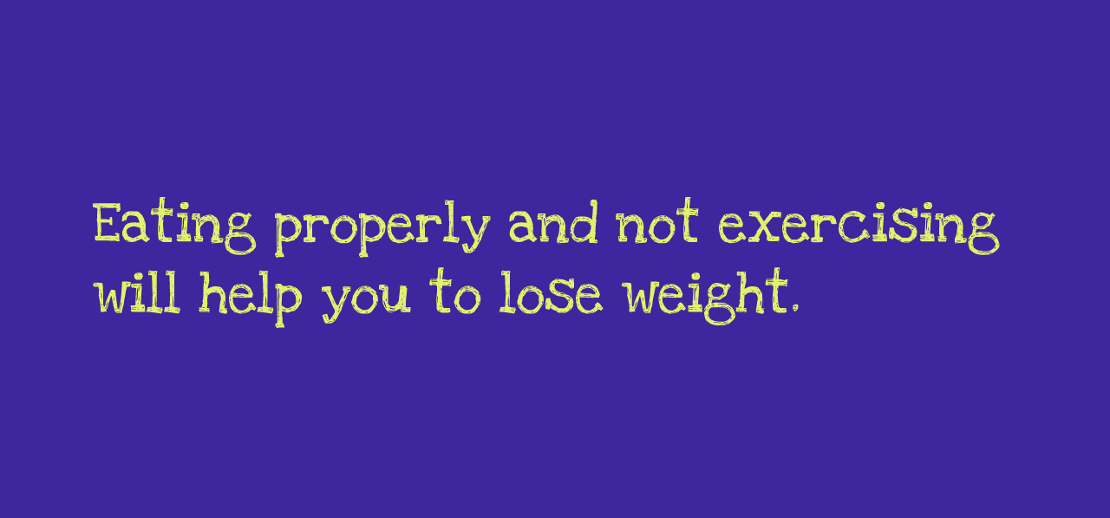

Slide 13
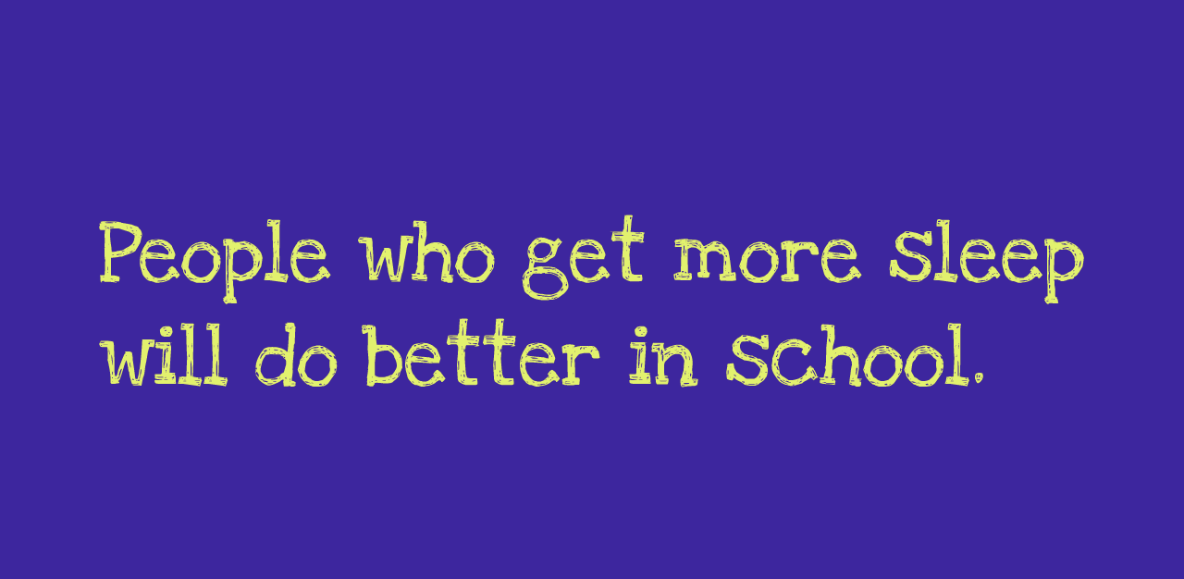

Slide 14
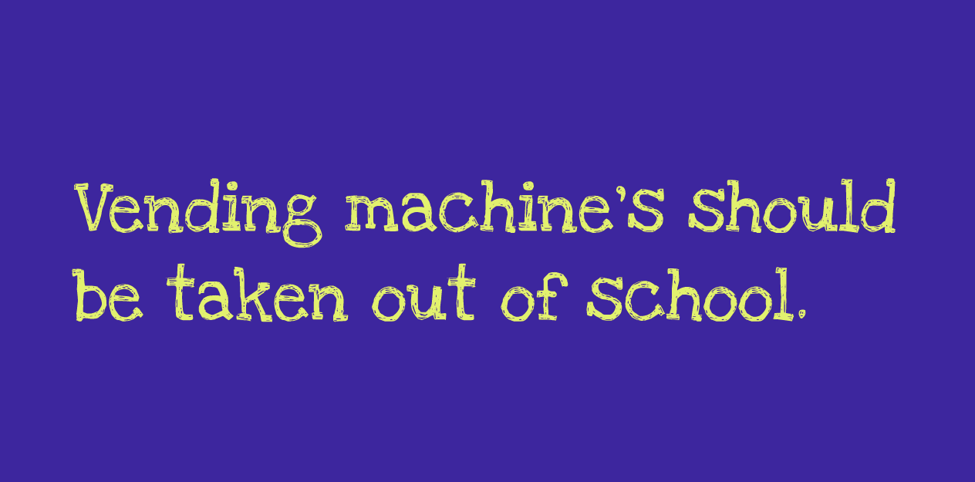

Slide 15
